Slide 1
Relational DBs for Political Science: Why you would benefit.
Rémi Cura Pf. In Song Kim

Slide 2
Today’s menu
Relational DBs for Political Science
Data matters
Typical Political Science Workflow
Relational DBs?
Workshop
The Lobbyview DBs
Live examples with the Lobbyview DBs

Slide 3
Data matters

Slide 4

Data matters
Why data matters:
Data is likely important for your research.
How you get intuition, how you prove.
→ If doubt on data, weakness.
Political Science findings
Data

Slide 5
Science: data goals?
Political Science
→Goals for research :
Reproducible : do it again?
Trackable : what happened
Explainable : why it happened.
Hard, best efforts

Slide 6
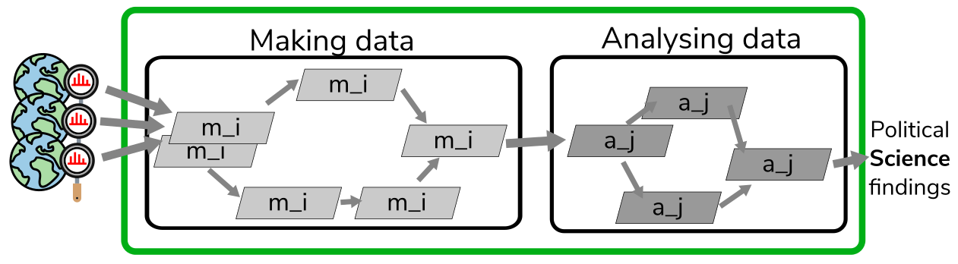
Science: 1. reproducibility?
1. Reproducible:
Updated data / Other scope?
Sharing
Researcher
your (future) self !
I’m still not there…

Slide 7
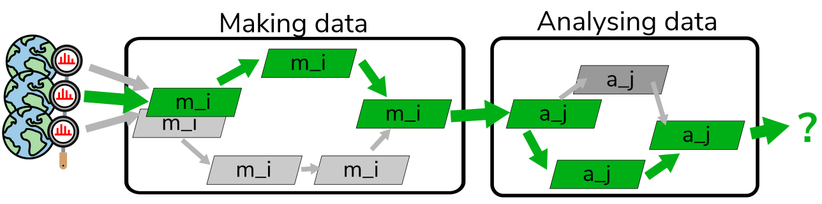
Science: 2. trackability?
2. Trackable:
Sources?
Processes applied?

Slide 8
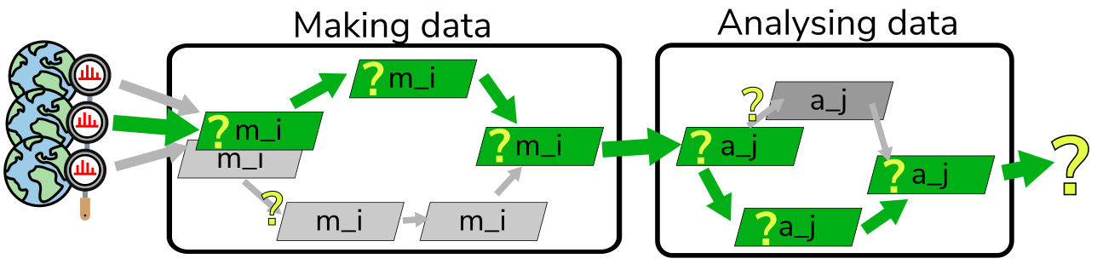
Science: 3. explainability?
3. Explainable:
Why it happened
Why it didn’t happen
→ Also for data cleaning !
Your experience?

Slide 9
Science : data goals?
OK, we just need to
Document everything
Track everything
Justify everything

Slide 10
Science : data gaols?
All set ,
thank you for your attention
Questions?

Slide 11
Political Science specificities
Kidding…
Reproducible + Trackable + Explainable: generic
What is specific for Political Science?

Slide 12
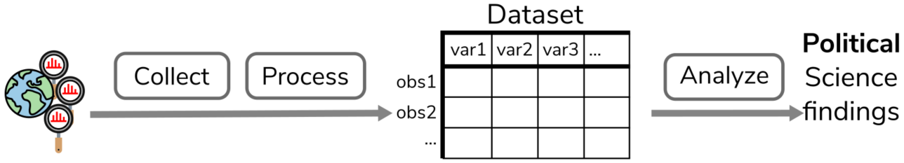
Typical workflow

Slide 13
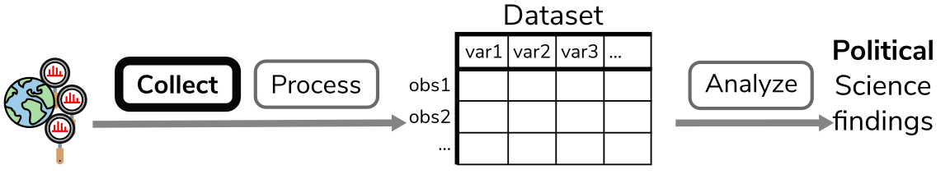
Typical workflow
Collect:
survey
scrape web
existing datasets
…

Slide 14
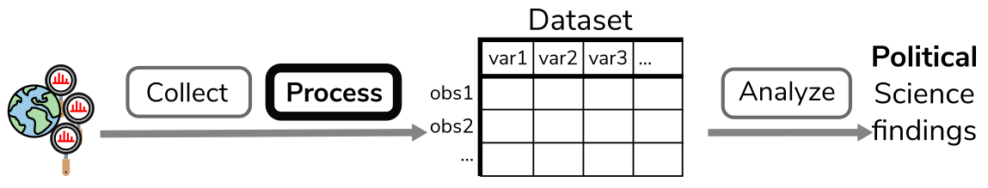
Typical workflow
Process:
extract
clean
merge
…

Slide 15
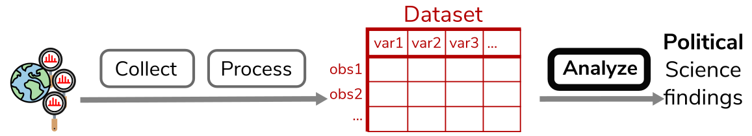
Typical workflow
Analyze:
regression
causal inf
ML
model fitting

Slide 16
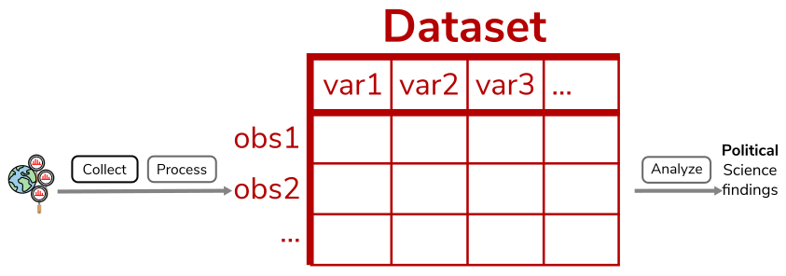
Typical workflow
Revolves around the mighty dataset…

Slide 17
About dataset
Strength and weakness

Slide 18
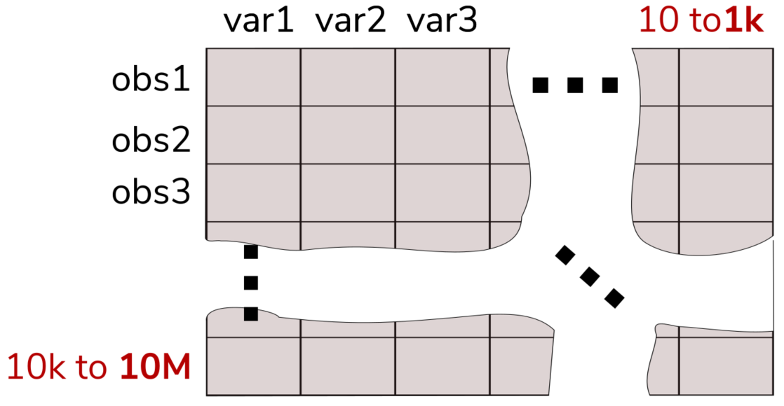
Dataset: pros
What is it (typically) : a big (sparse + redundant) matrix

Slide 19

Dataset: pros
What is it good for?
Analysis
Simplicity
Dirty sharing

Slide 20
Dataset: pros
Very good for analysis
→ keep using it for that !
Simple
→ good for quick and dirty
… Bad for everything else

Slide 21

Dataset: cons
What is it bad for?
Storage
Update
Reuse / sharing
Quality

Slide 22
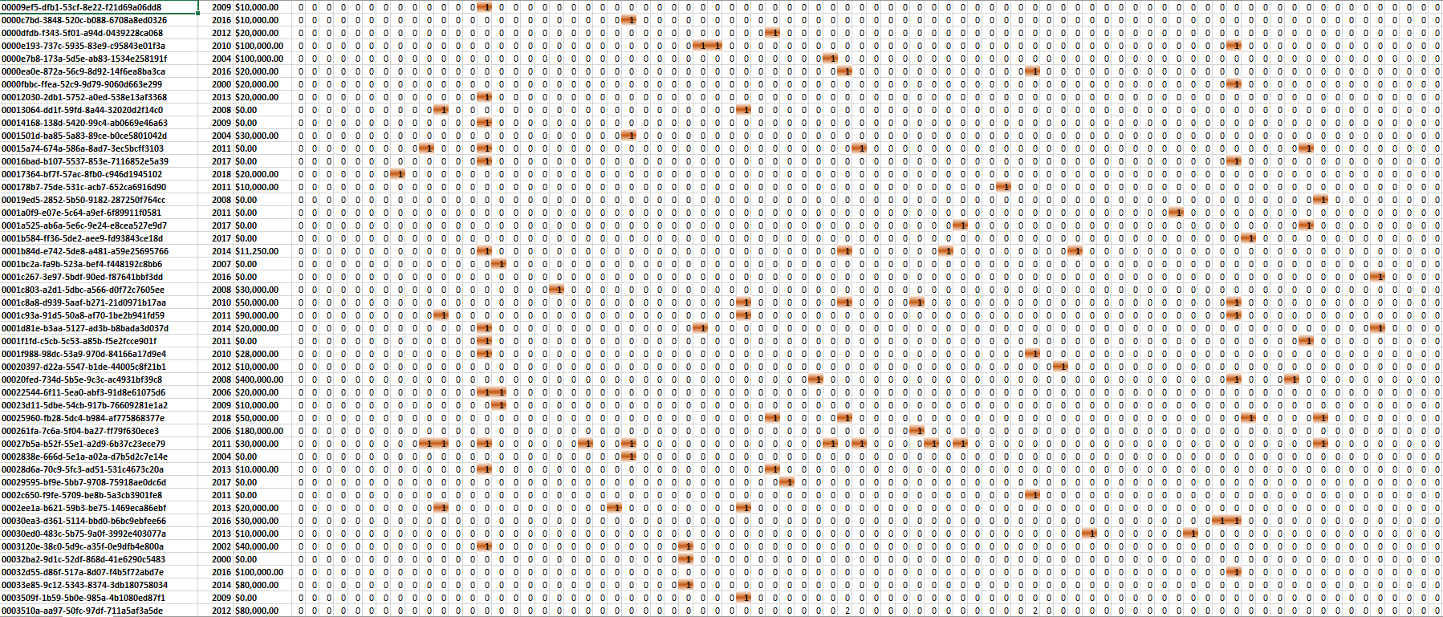
Dataset: cons: storage
- Storage
Lots of columns → very sparse → bad for storage (In Song Trade dataset: 1.5 TeraB, should be 99% smaller )

Slide 23
Dataset: cons: storage
- Update and re-use
Lots of duplicated values → bad for update and re-use

Slide 24
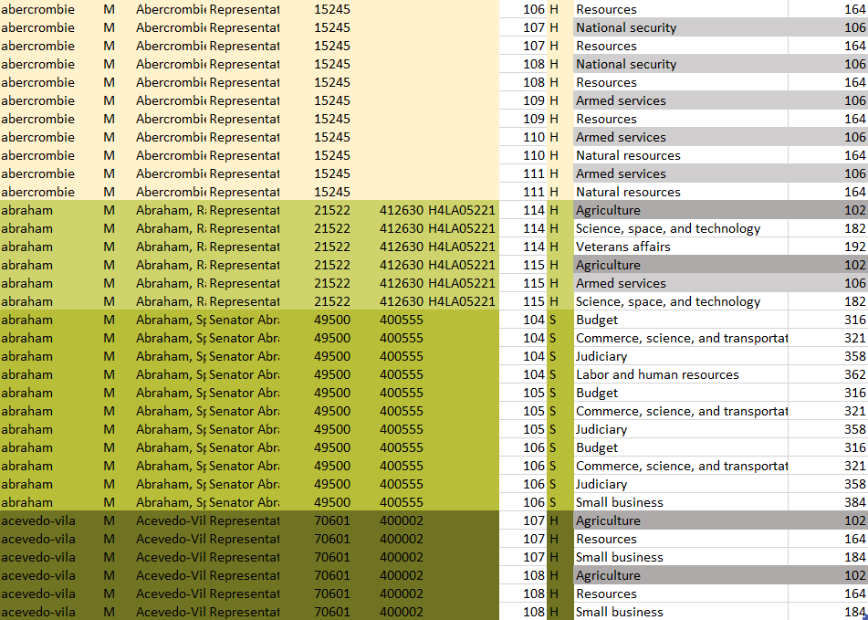
Dataset: cons: storage

Slide 25
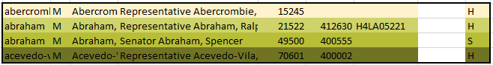
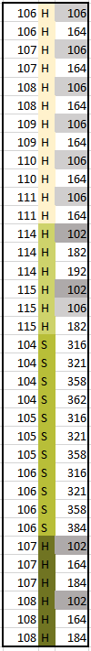
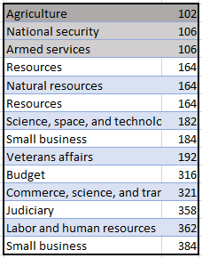
Dataset: cons: storage
=

Slide 26
Dataset: cons: storage

Slide 27
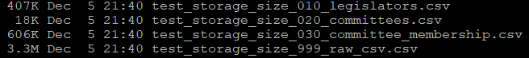
Dataset: cons: storage
No useless repetition?
Big dataset : RAM issue
3.3M : raw (dirty) CSV file
1.2M : 3 equivalent (dense) CSV files

Slide 28
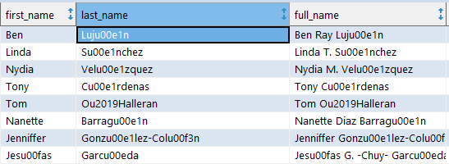
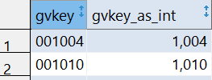
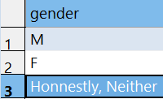
Dataset: cons: storage
- Quality nightmare
Data easily corrupted (encoding, typo)
No types
No specific values enforced
No coherence
= no guarantees whatsoever
→ It will go bad

Slide 29
Workshop: Where's Waldo?
Find the problems in the (real life) dataset

Slide 30
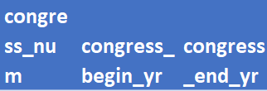
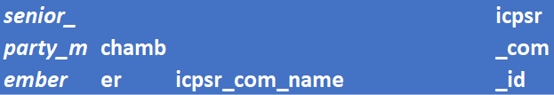
Dataset: errors
Where's Waldo?

Slide 31
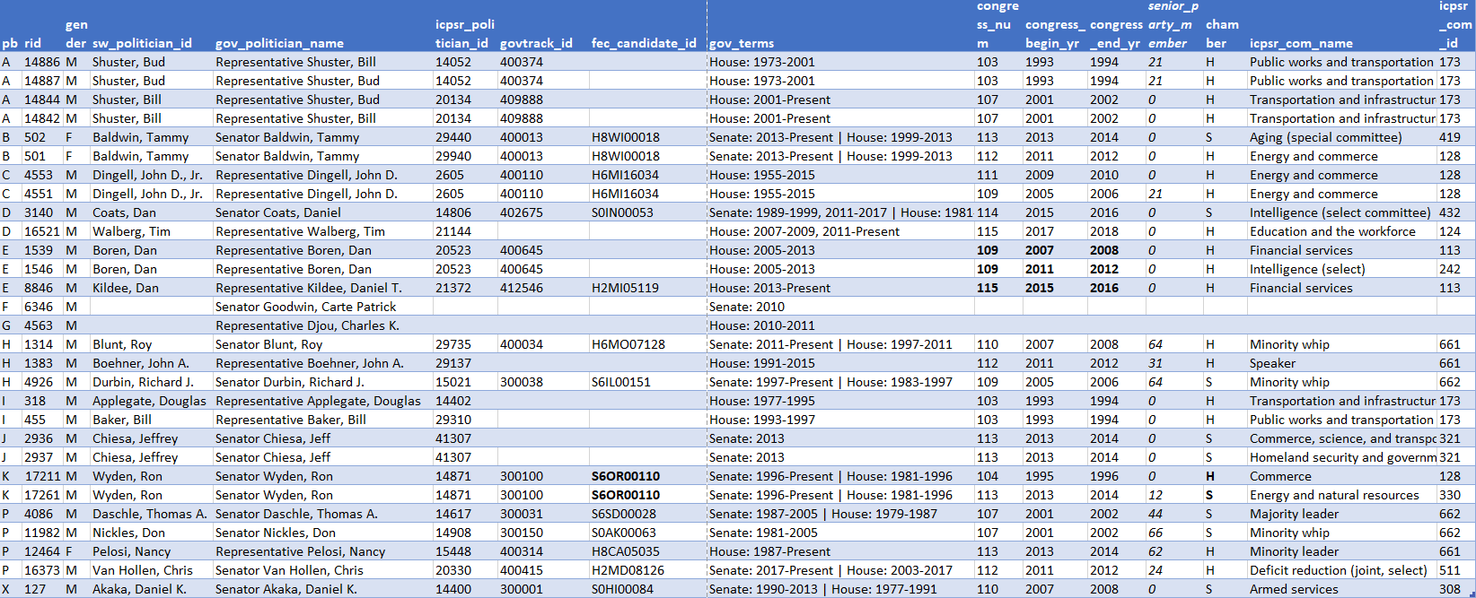
Dataset: errors
Where's Waldo?
Find the errors in (Charles Stewart + corrected by In Song RAs)

Slide 32
Dataset: errors
A : duplicate name : merging went wrong
B: same govtrack_id, different icprs_politician_id
C, P: senior party member?
D, F: gov_terms formatting
E: gov_terms says present, year says 2018
G: NA for committees
H: icpsrs_com_id not coherent with com_name(+…)
I, J: should be same committee name
K: same fec_candidate_id, but campaign for Senate and House
X : control

Slide 33
Dataset: errors
30 rows of a 18k rows file
Most of the errors because redundancies
Could be avoided:

Slide 34
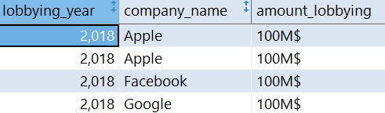
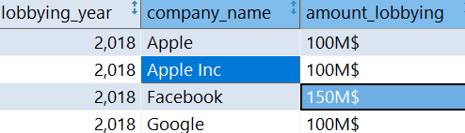
Dataset: errors
Many errors. What are the consequences?
Add noise
People get counted too much/not enough
Over/under estimating effect/treatment
Invalid inference
Down stream spillover for future research
$ per year per comp?
Biggest lobbying comp?

Slide 35
Dataset: errors
Bad news:
Most cases : silent error
After dozens of CSVs : error rate can be 10%
Most of the time OK-ish
Nightmare case:
any effect < 10% could be a fluke…

Slide 36



Dataset: solution
Dataset issues get worse as:
Complexity
Scale
Users/Colleagues/Scope
(you graduate and keep using your data)

Slide 37
What can we do?

Slide 38
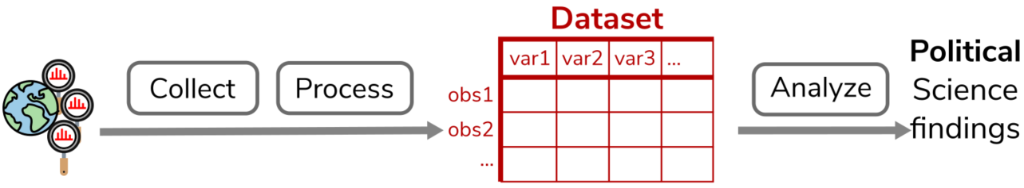
Dataset: solution
Instead of

Slide 39
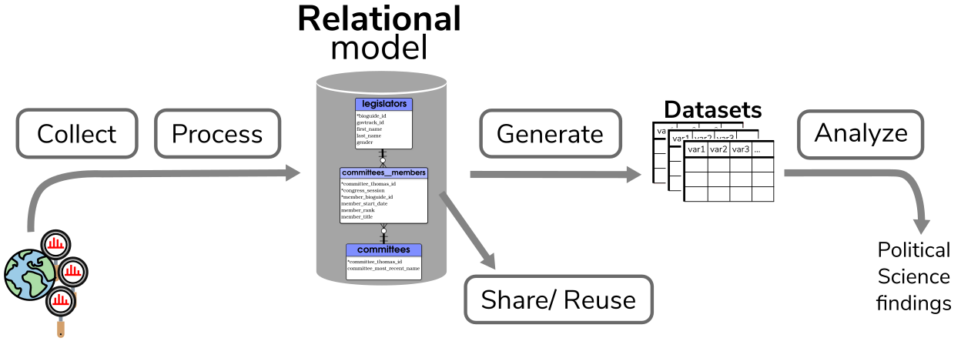
Dataset: solution
Do:

Slide 40
Relational model
Organize the data

Slide 41
Relational model: goal
Goal is to :
Organize the data
Enforce the structure
Then generate the datasets as needed

Slide 42
Relational model: what is it?
Relational model:
Entities: legislator / a committee / a bill …
uniquely defined
Relations
1 Legislator is in 0 or N committees
1 committee has 1 or N legislators
…

Slide 43
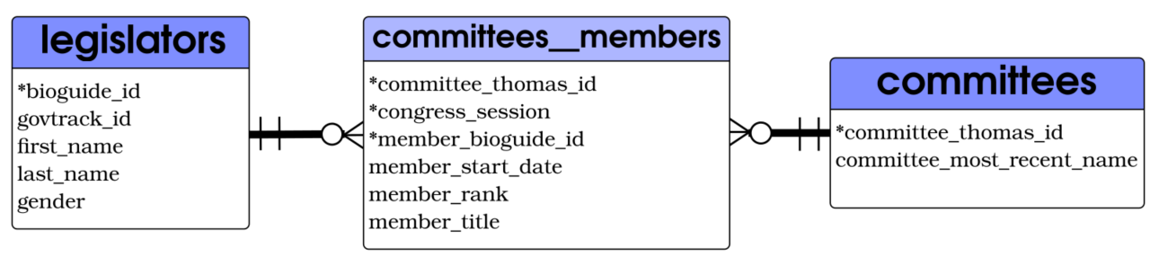
Relational model: legislator-commitees
Relational model:
One real life person
Whatever the chamber
All info that does not change for this person
A unique id

Slide 44
Relational model: legislator-commitees
Relational model: Example in SQL
CREATE TABLE legislators (
bioguide_id text,
govtrack_id text,
first_name text,
last_name text,
gender varchar(1) CHECK(gender=‘F’ OR gender=‘M’),
PRIMARY KEY (bioguide_id)
);

Slide 45
Relational model: legislator-commitees
Relational model:
One real life committee
A unique id
The most recent name (official name)

Slide 46
Relational model: legislator-commitees
Relational model:
Committee membership
For one congress, (legislator, committee) is unique
Info about this membership

Slide 47
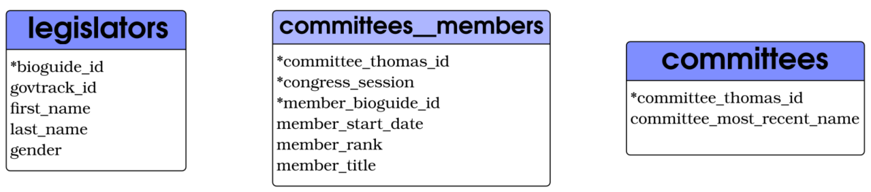
Relational model: legislator-commitees
Relational model:

Slide 48
Relational model: legislator-commitees
Relational model:
(1) committee
1 legislator
has
has
(0,n) membership (0,n)

Slide 49
Relational model: legislator-commitees
Relational model:
1 to Many
Many to 1

Slide 50
Relational model: legislator-commitees
=

Slide 51
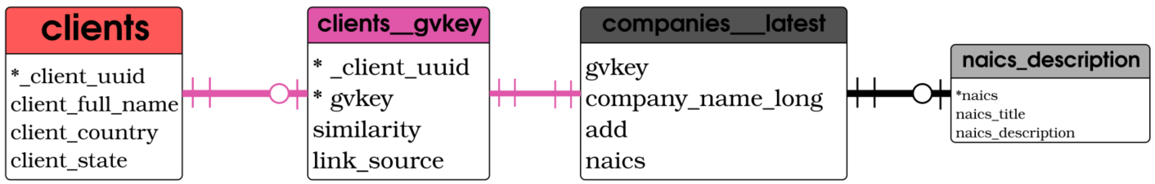
Relational model: Lobbying clients-Naics
Relational model:

Slide 52
Relational model: Lobbying clients-Naics
Relational model:
(1) lobbying client
has
(0,1) gvkey
associated to
(1) companies
with
(1) Naics code

Slide 53
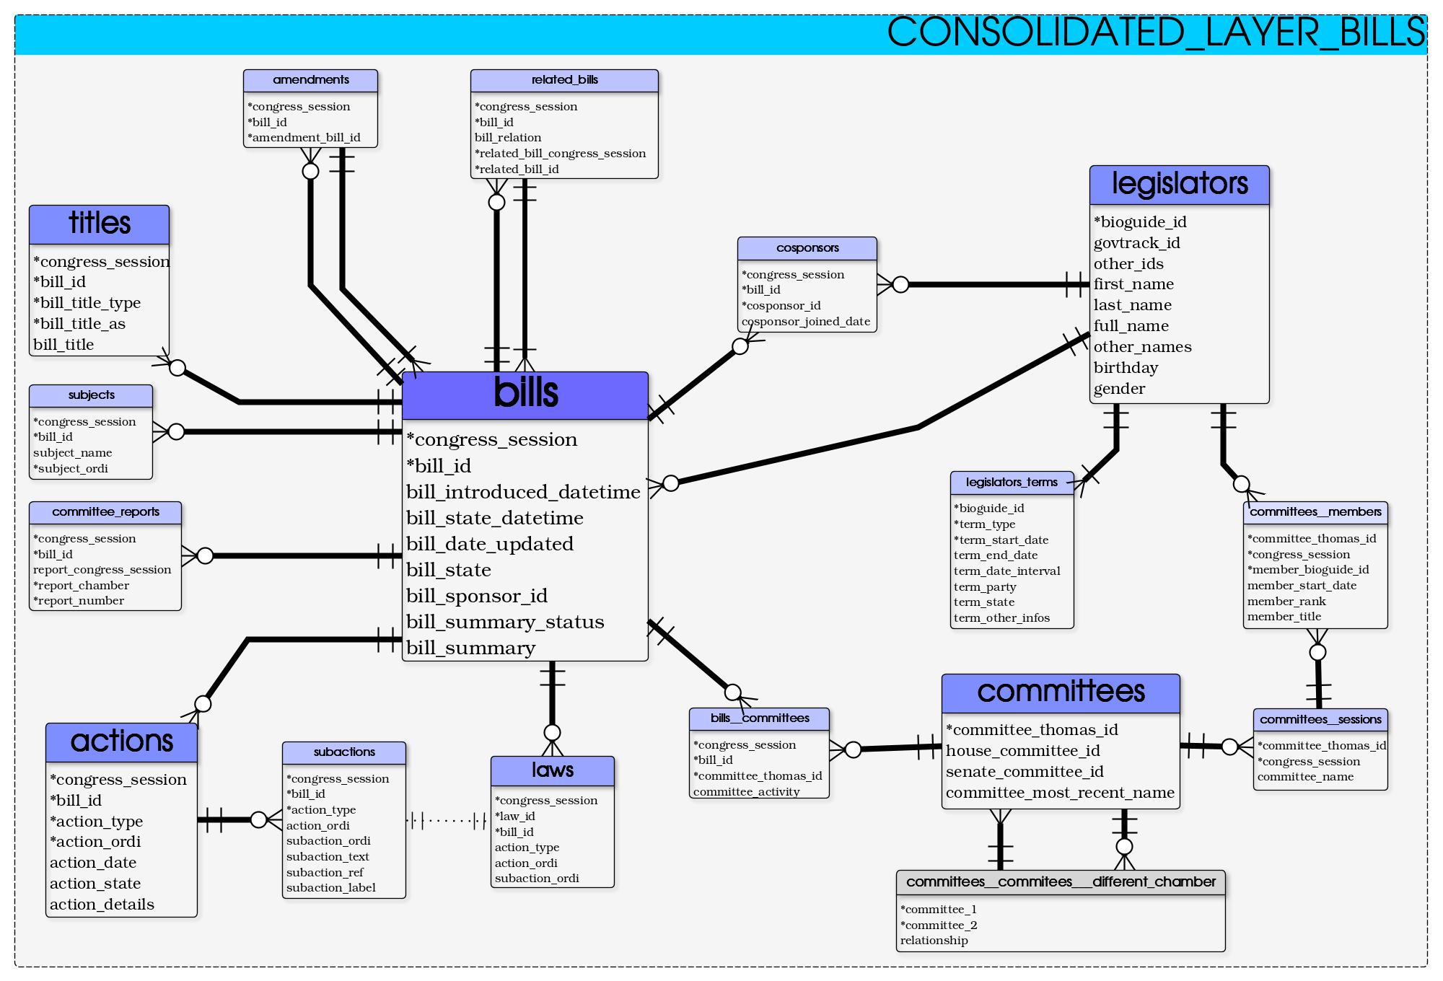
Relational model
Could be a lot of work:

Slide 54
Relational model: Benefits
Why bother?

Slide 55
Relational model: benefits
How many months collecting the data?
many
How much care designing the experiments
A lot
Will you update/reuse?
Very likely
Do you want to share/disseminate your work?
A lot

Slide 56
Relational model: benefits
Can you afford wasting part of your work?
Better data quality
Scaling (complexity, volume, several users…)
Generating new datasets
Easier sharing/merging/reusing
Some very advanced capabilities

Slide 57
Relational model: benefits
Merging everything in one dataset:
Combinatorial (exponential)
Relational model
Linear in size
( ln(n) with indexes)
→convenient to add more stuff

Slide 58
Relational model: benefits
Merging everything in one dataset:
Combinatorial (exponential)
Relational model
Linear in size
( ln(n) with indexes)
→convenient to add more stuff

Slide 59
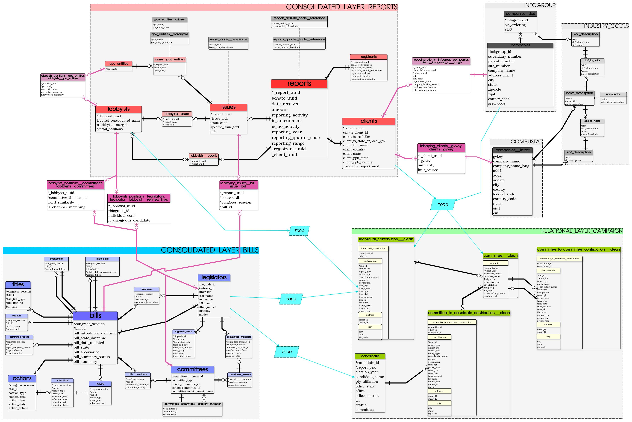
Relational model: benefits
Convenient to make your DB grow organically

Slide 60
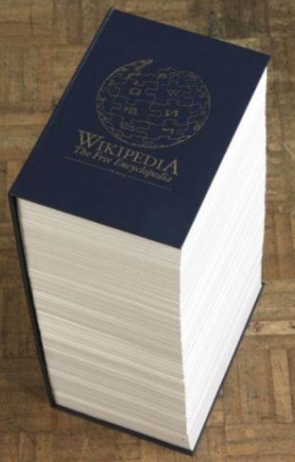
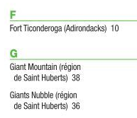
Relational model: benefits
Scaling?
50 years of optimization?
Indexing
Story about looking at your data

Slide 61
Relational model: How TO DO IT?
(Realistically)

Slide 62
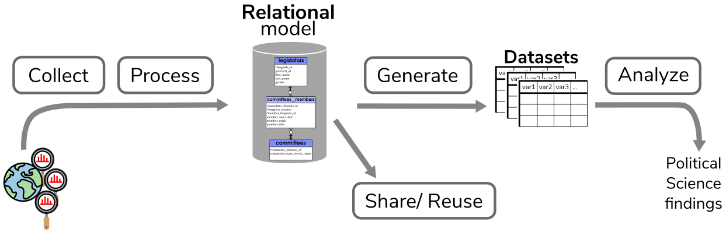
Relational model: how to?

Slide 63
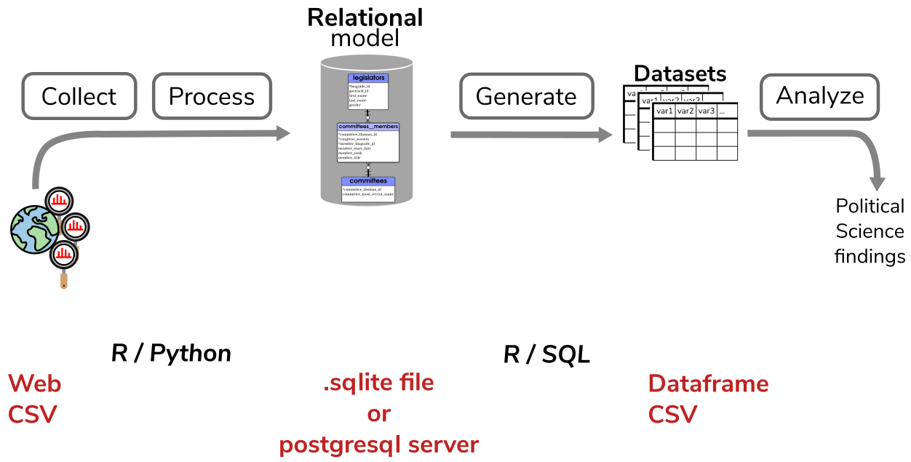
Relational model: how to

Slide 64
Conclusion
(Short)

Slide 65
Conclusion
Typical workflow : problematic (reproducibility, trackability, explainability) + (re-use / sharing, scaling, data quality)

Slide 66
Conclusion
Model your data to solve these issues

Slide 67
The Lobbyview DBs
Rémi Cura Pf. In Song Kim

Slide 68
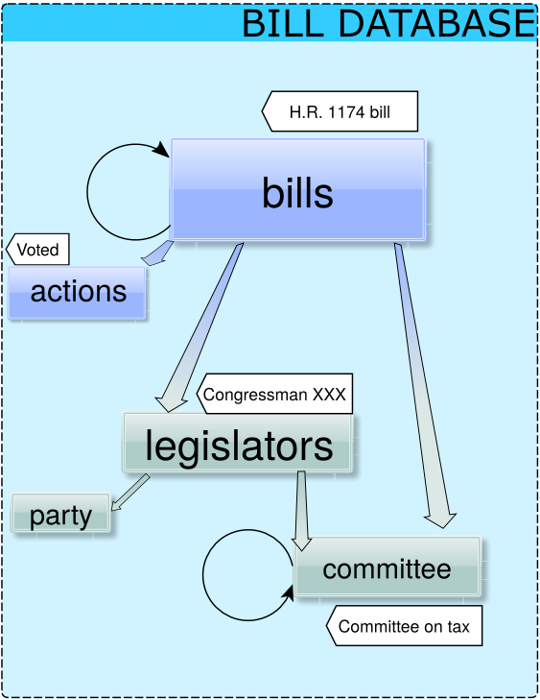
The Lobbyview DBs: entities

Slide 69
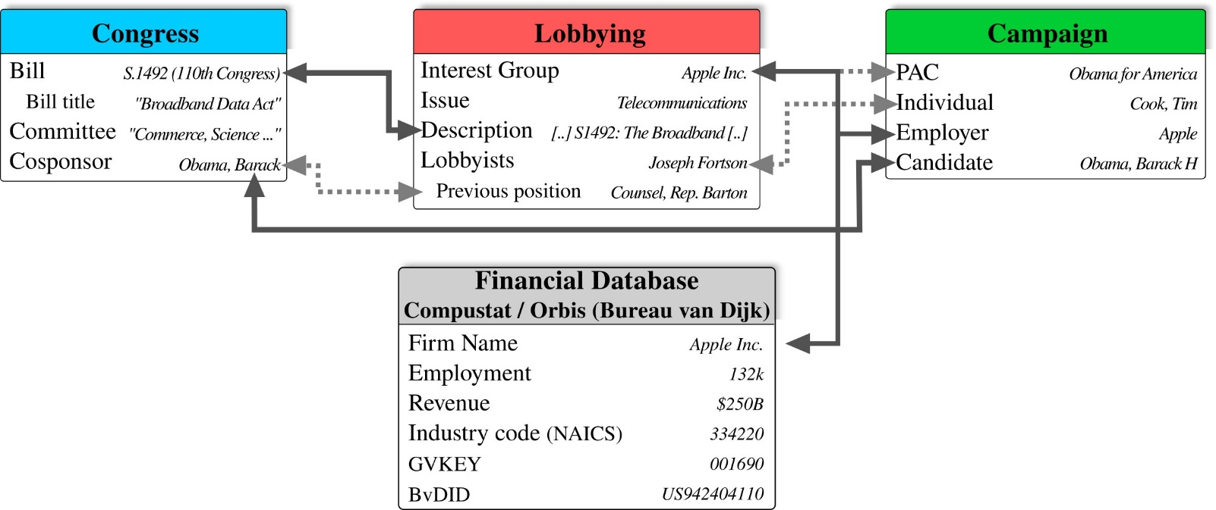
The Lobbyview DBs: entities

Slide 70
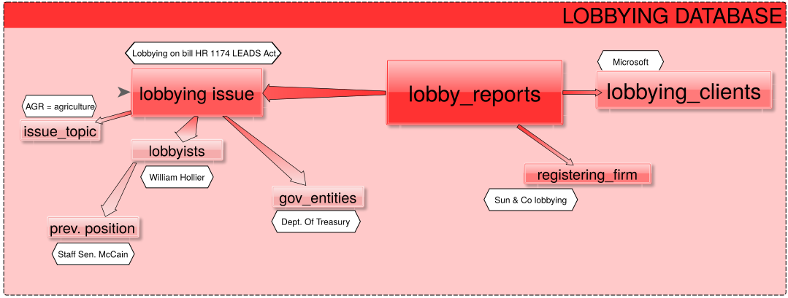
The Lobbyview DBs: entities
-

Slide 71
The Lobbyview DBs: entities

Slide 72
The Lobbyview DBs: entities

Slide 73
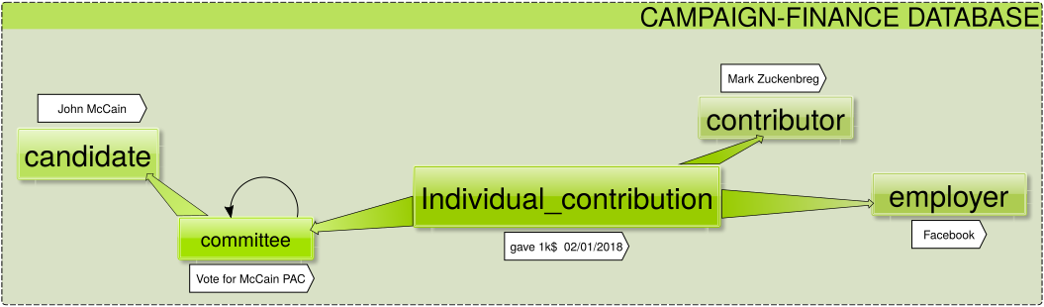
The Lobbyview DBs: entities

Slide 74
The Lobbyview DBs: entities

Slide 75
The Lobbyview DBs: entities

Slide 76
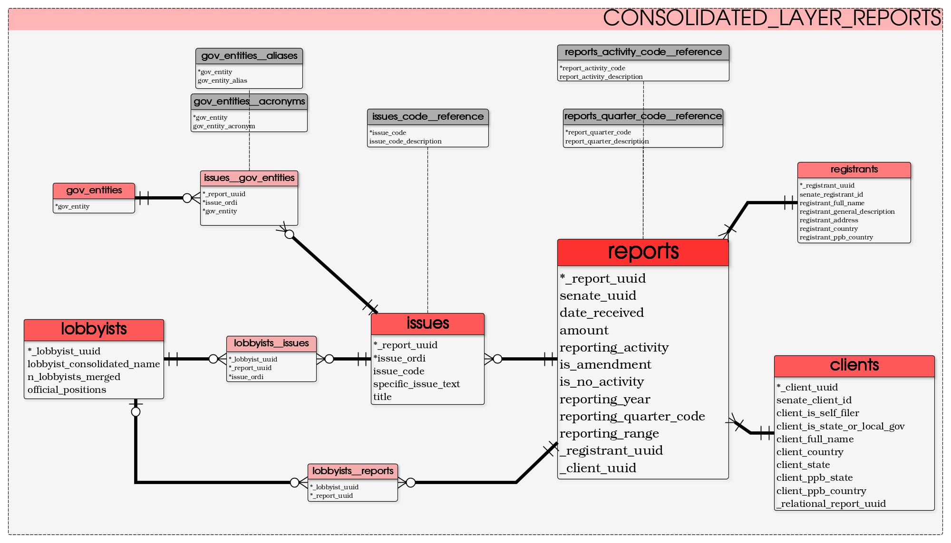
The Lobbyview DBs: entities

Slide 77
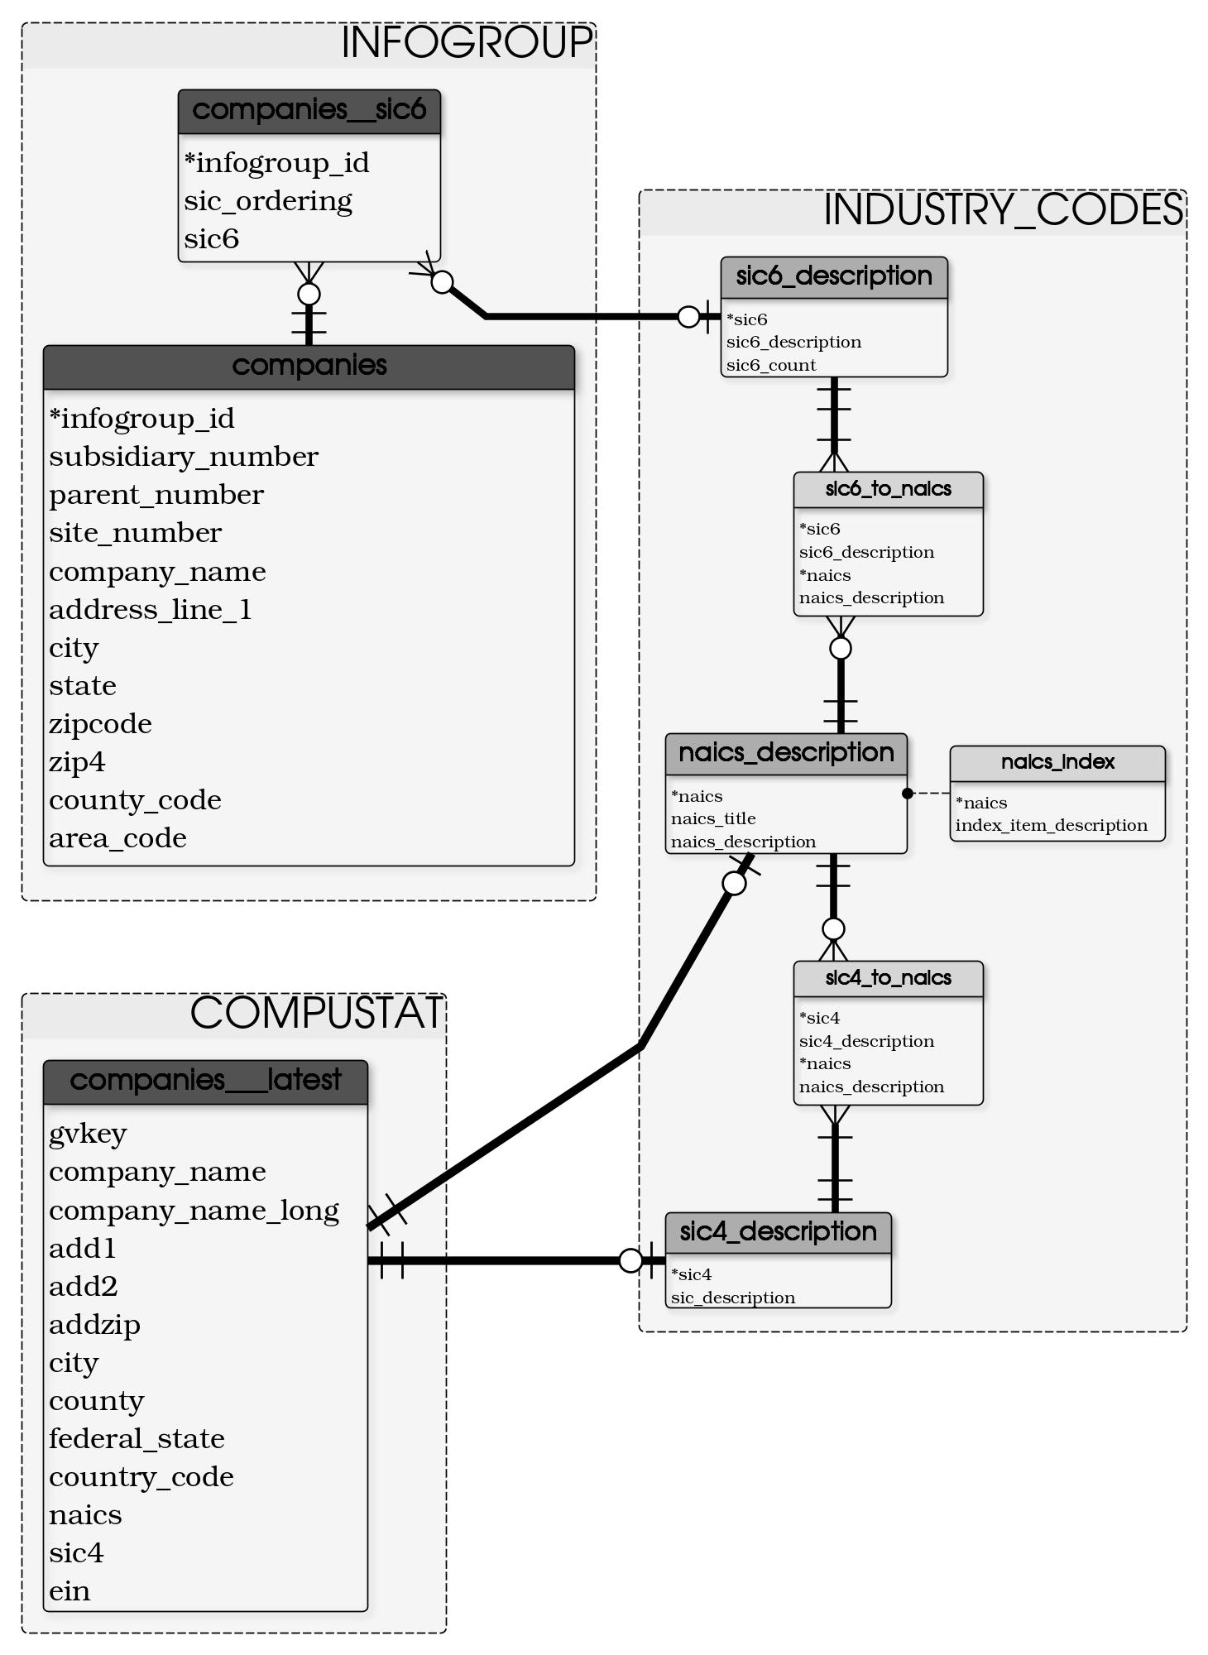

Slide 78
Appendix

Slide 79
Relational model: how to
Model your data : (SQL / Python)
Entities
types
constraints
what is unique?
Relations

Slide 80
Relational model: how to
Fill the model : (R / Python / SQL)
Clean :
Insert into the model : R / Python / SQL
Generate Dataframes: R / SQL
Probably easiest part

Slide 81
Practical architecture
(Realistically)

